Slide 1
ScorPala Patrol Troop 1313
ScorPala Patrol
Troop 1313

Slide 2
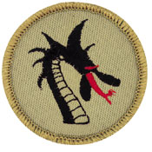
Dragon Patrol Troop 1313
Dragon Patrol
Troop 1313

Slide 3
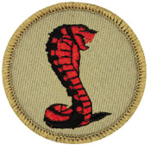
Cobra Patrol Troop 1313
Cobra Patrol
Troop 1313

Slide 4
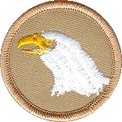
Eagle Patrol Troop 1313
Eagle Patrol
Troop 1313

Slide 5
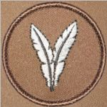
Flying Ostrich Patrol Troop 1313
Flying Ostrich Patrol
Troop 1313

Slide 6
Koala Bear Patrol Troop 1313
Koala Bear Patrol
Troop 1313

Slide 7
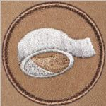
Duct Tap Patrol Troop 1313
Duct Tap Patrol
Troop 1313

Slide 8
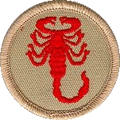
Scorpion Patrol Troop 1313
Scorpion
Patrol
Troop 1313

Slide 9
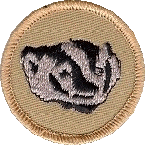
Badger Patrol Troop 1313
Badger Patrol
Troop 1313

Slide 10
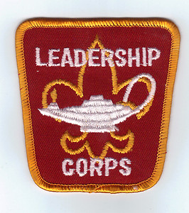
Troop Leadership Corps Troop 1313
Troop Leadership Corps
Troop 1313

Slide 11
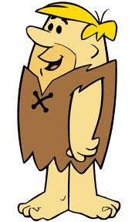
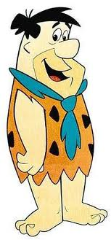
Dad Patrol Troop 1313
Dad Patrol
Troop 1313

